Slide 1
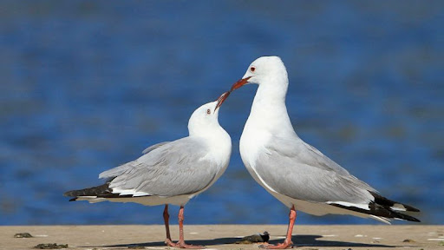
Best, most sophisticated, confident and accurate model to forecast population dynamics of Hartlaub’s Gull at Paarl Bird Sanctuary

Slide 2
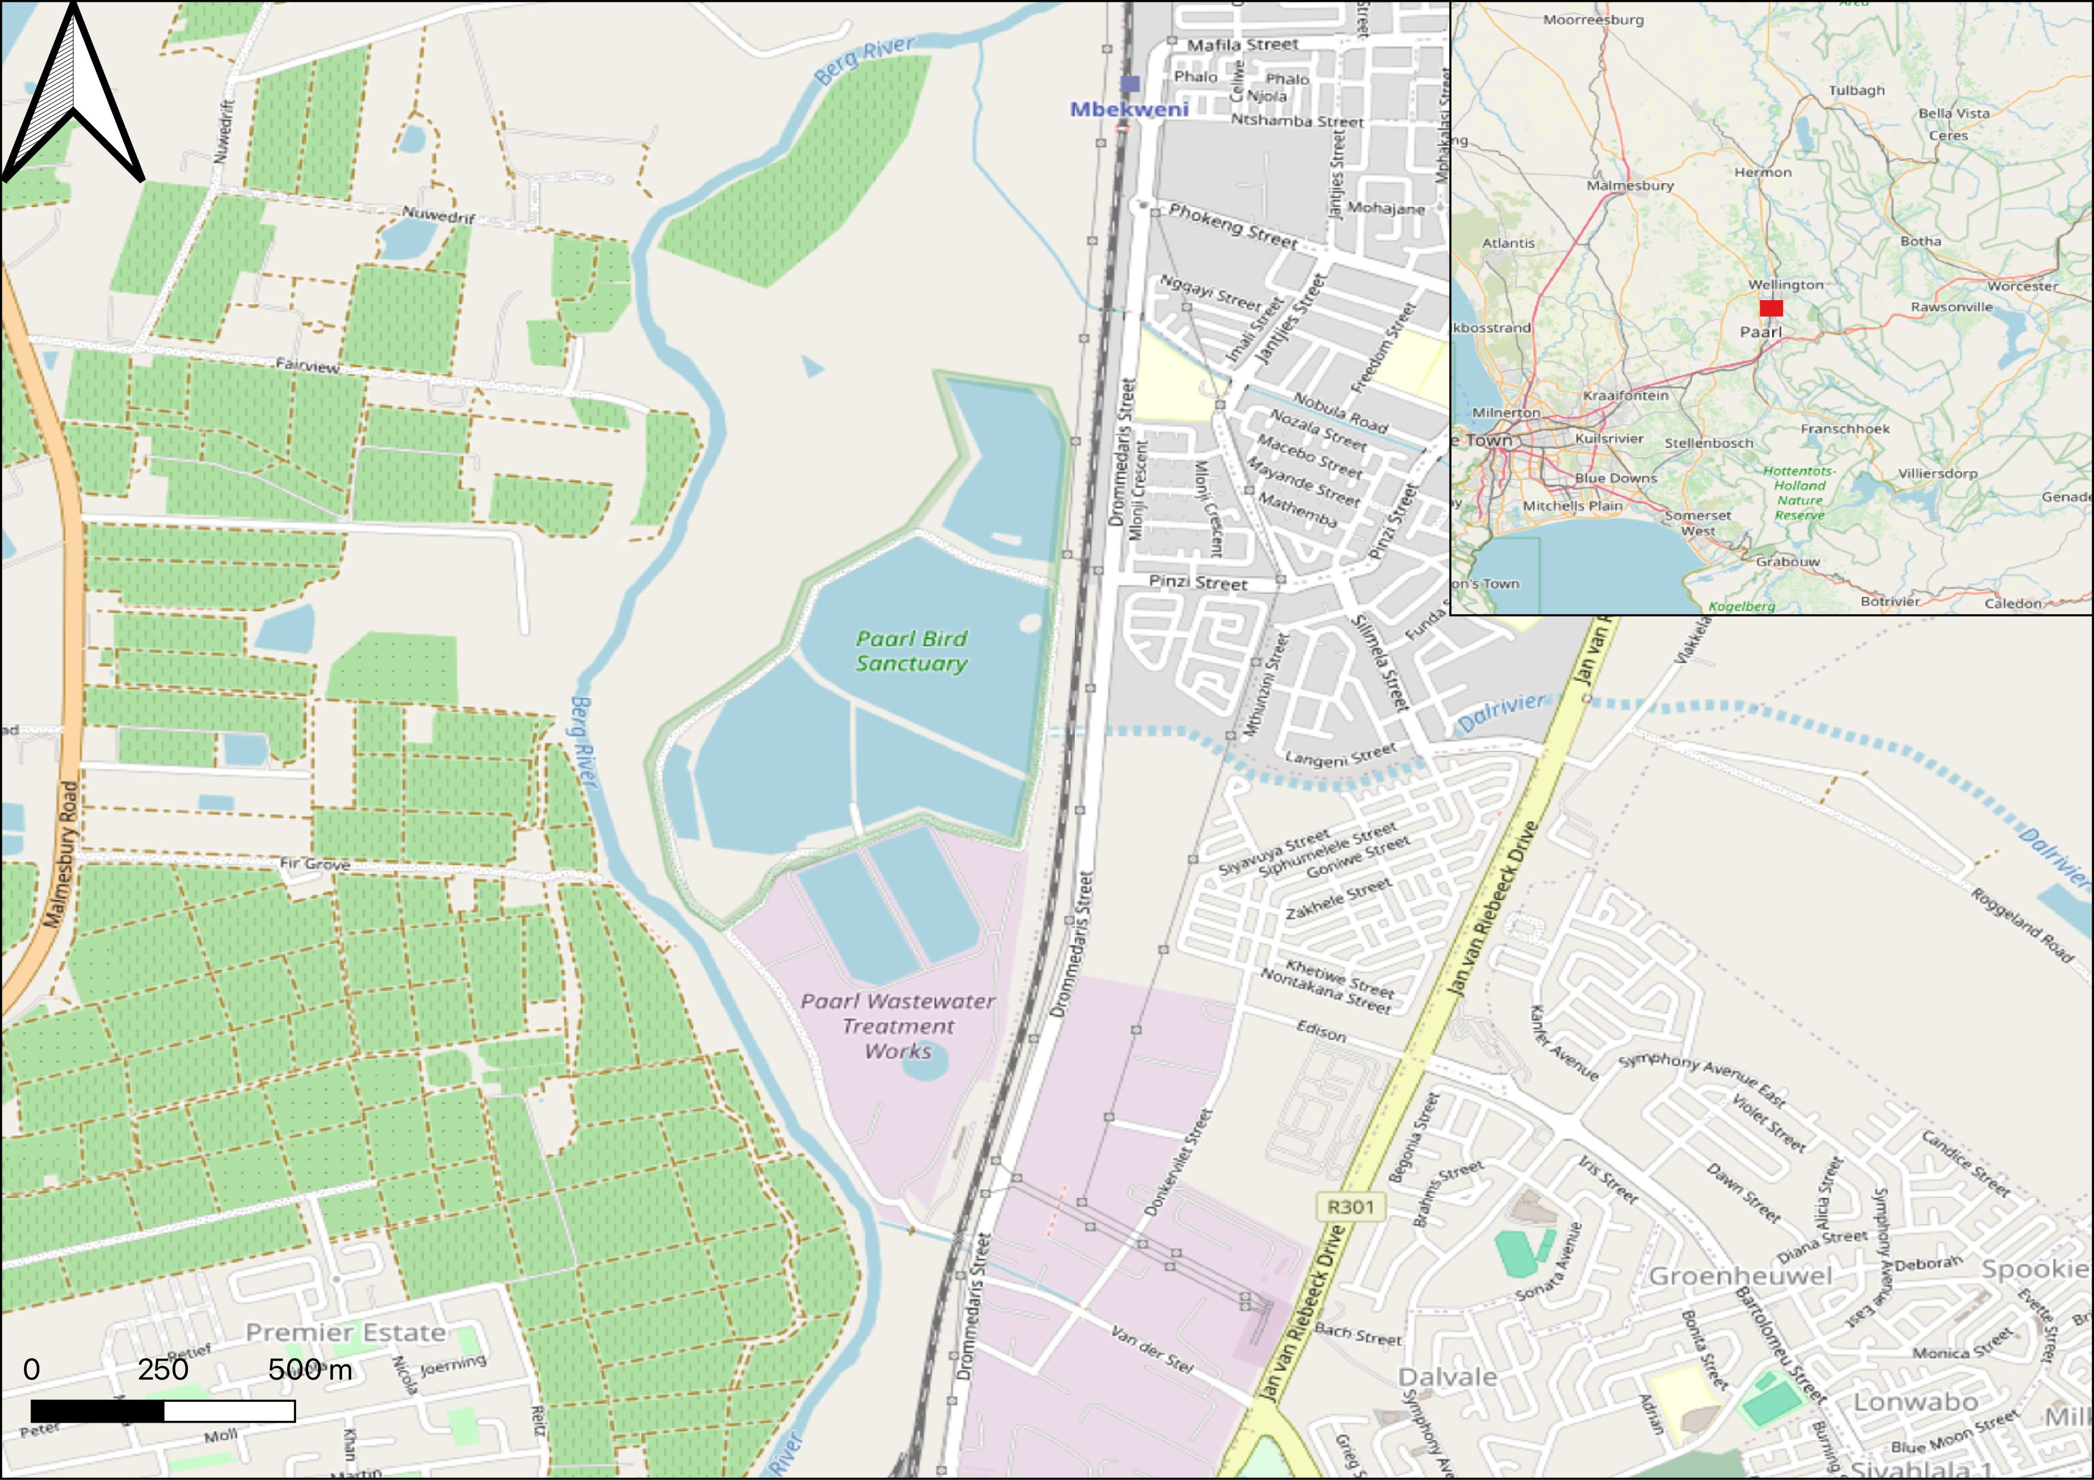
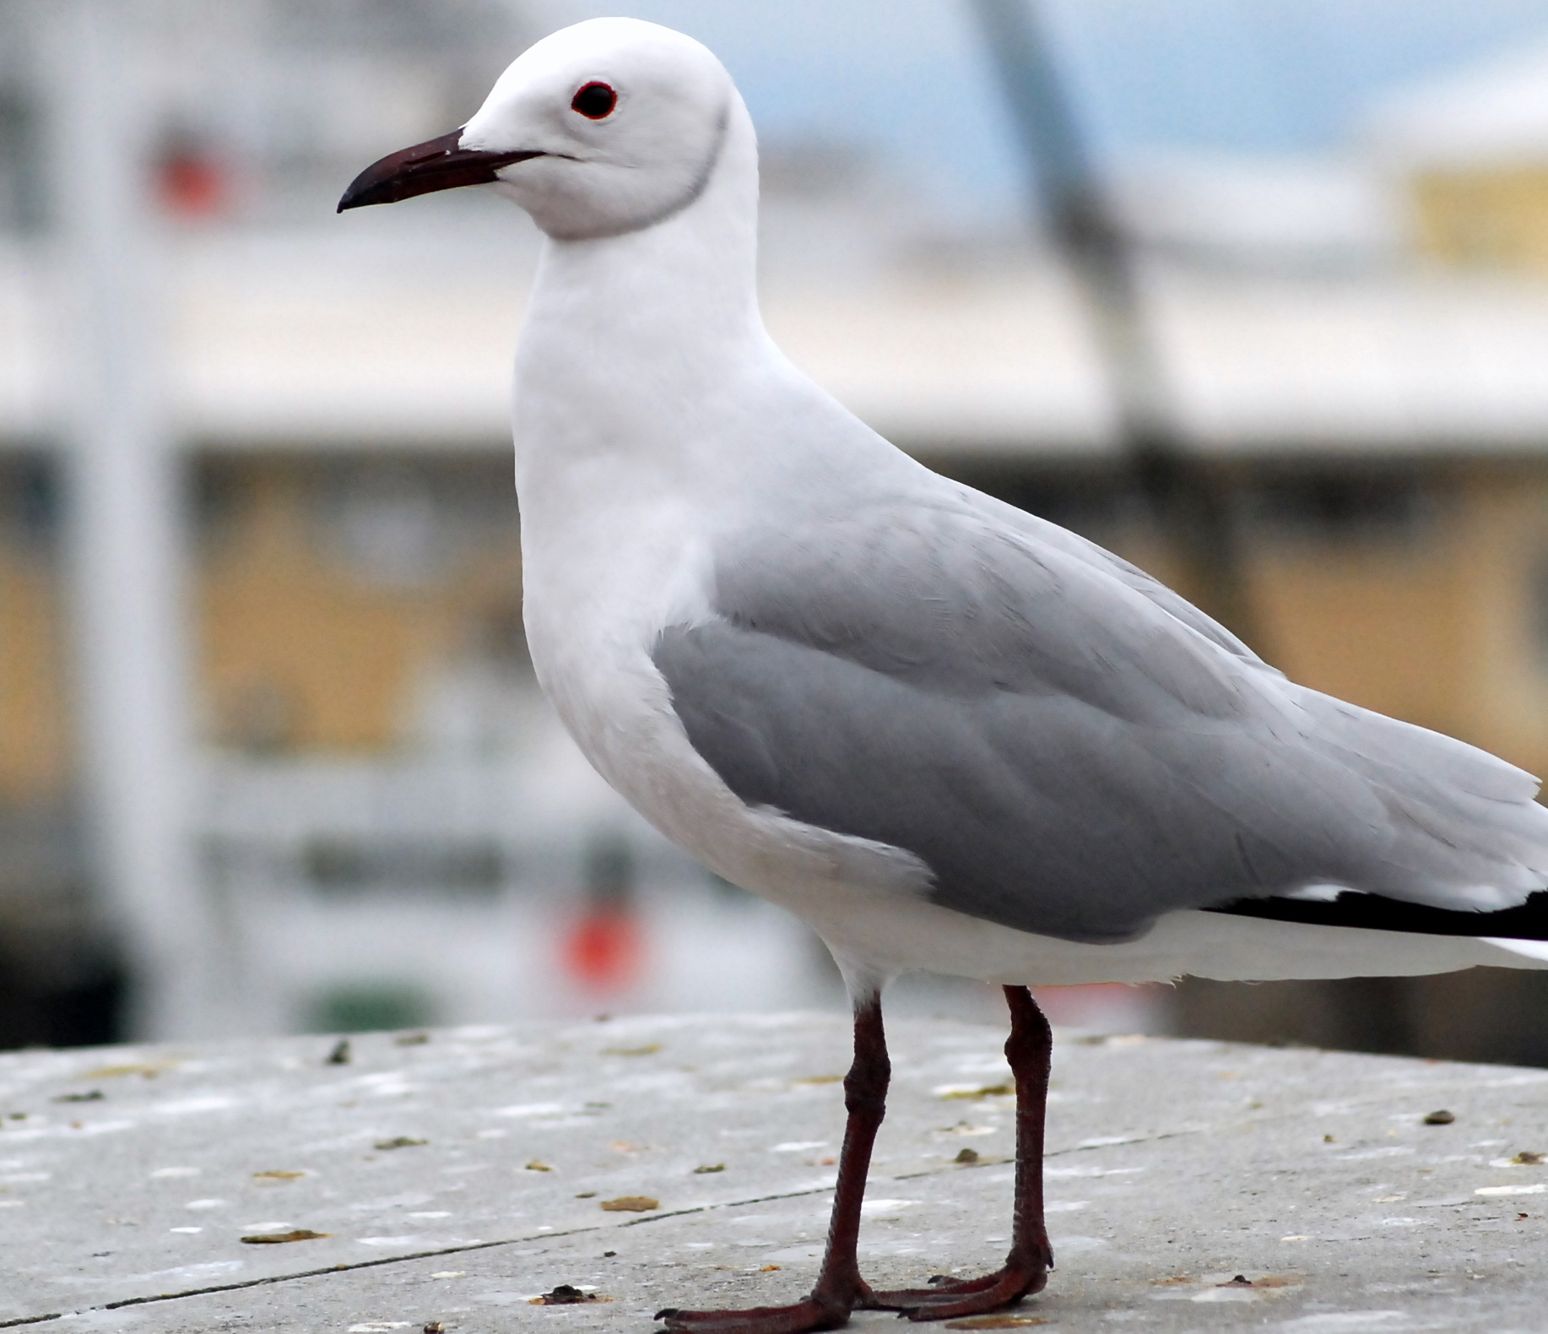

Slide 3
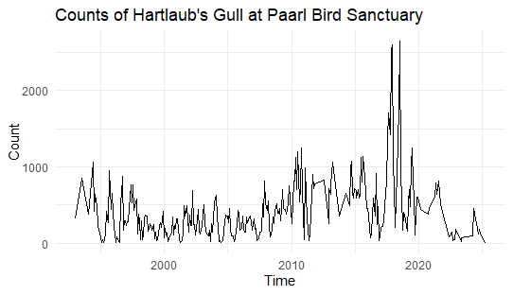

Slide 4
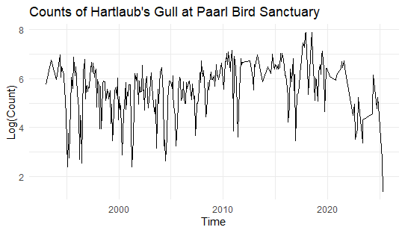

Slide 5
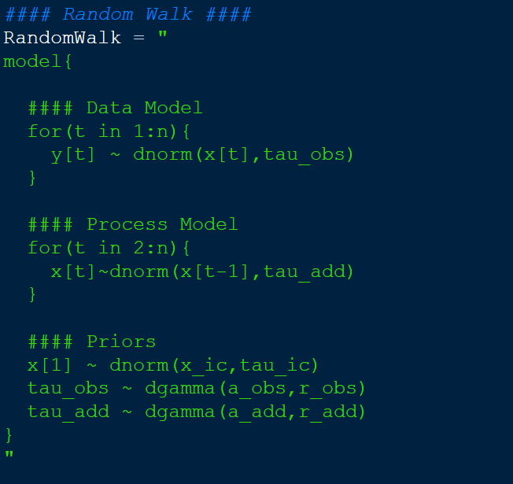

Slide 6
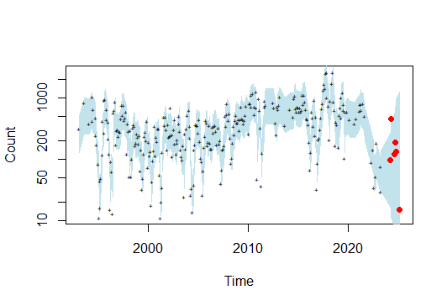

Slide 7
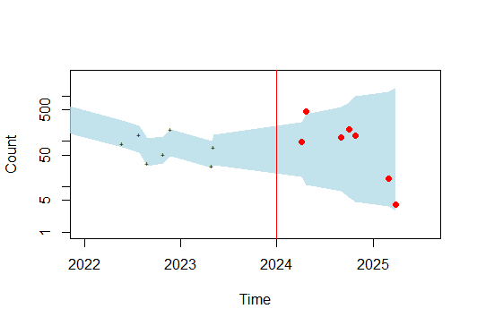
Initial Prediction
Posterior CI at unobserved time-steps plotted against omniscient knowledge of observed counts

Slide 8
Iterative Forecasting Process
Assume constant observation error and process error (on log scale) based on posterior means. Not properly propagating uncertainty!
Kalman Filter
Single time-step forecasting

Slide 9
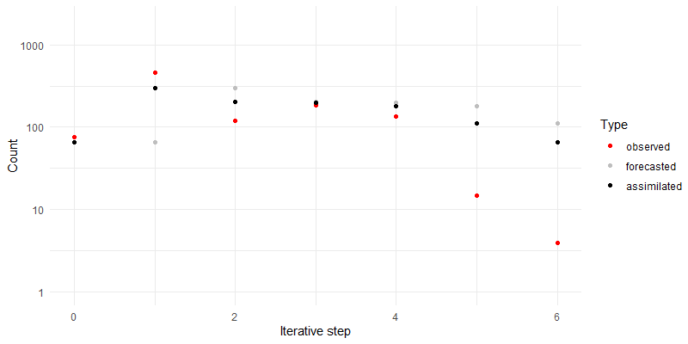
The forecasting process

Slide 10
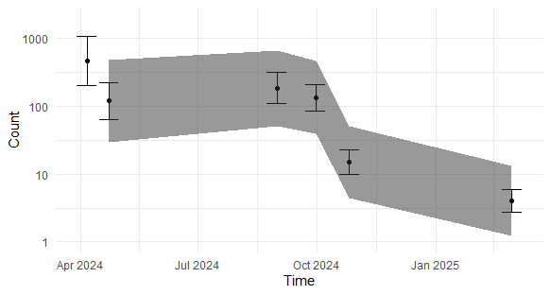
Forecasted CIs
With omniscient observations and observational uncertainty

